Slide 1
Hadoop I/O
File-based Data Structures

Slide 2
File-Based Data Structures
For Some applications, we need a specialized ‘Data Structure’ to hold data.
We can put each blob of binary data into its own file, but this doesn’t scale for MR parallel processing.
Hadoop contains a no of higher level containers for holding the blobs, which can scale. They are
Oldest file formats in Hadoop
SequenceFile (row oriented)
MapFile (row oriented)
Newer alternatives/projects are
AVRO data files (row oriented)
Hive RCFile (Column oriented) – Record Columnar File
Hive ORCFile (Column oriented) – Optimized Record Columnar File
Parquet (Column oriented) – (file format based on Google’s Dremel)
AVRO – Trevni (Column oriented)

Slide 3
SeqeunceFile
SequeceFile provides a data structure for Binary Key-Value pairs.
E.g. uses are log file where we can choose time stamp as key(LongWritable) and value is the log entry.
SequenceFile best suited for Binary types(byte[],images,captcha images, plain byte steam sent by sensors etc..)
SequenceFiles works with large and small files as well.
HDFS and MR are optimized for large files.
Hence packing smaller files into sequenceFile makes storing and processing smaller files more efficient.

Slide 4
In SequenceFile, the Writer inserts a special entry to make some Sync points for every few records while writing the file.
These sync points are used to resynchronize with a record boundary if the reader is lost.
The overhead of sync points is less than 1%.
Sync points supports the record boundaries.
Sync points are greatly useful while processing sequence files as input to MR processing. How?
The files are split and are used independently by Map tasks
The record boundaries can be easily detected using these sync points.

Slide 5
Display sequence file with CLI
Hadoop fs command has –text option to display the files in text format.
The –text option can recognize gzip, sequence file and Avro data files based on the “magic number” of file. If no magic no matches, it assumes input as plain text.
Magic numbers are the first bits of a file which uniquely identify the type of file. This makes programming easier because complicated file structures need not be searched in order to identify the file type.
Refer - https://en.wikipedia.org/wiki/Magic_number_(programming)

Slide 6
You can Merge and Sort sequence files using
MR programming.
Using SequenceFile.Sorter class - here you need to partition data manually to process them parallel. MR automatically make use of parallelism.

Slide 7
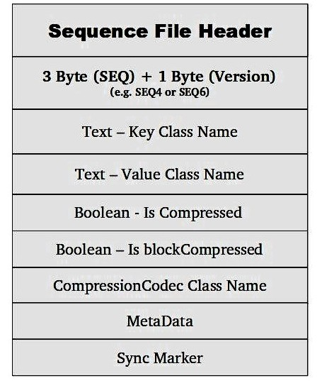
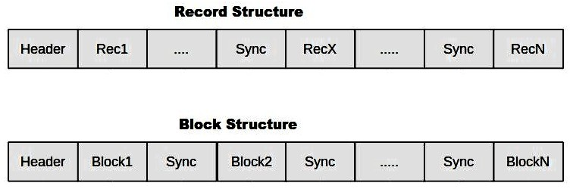
SequenceFile Format
There are three optional internal storage format:
"Uncompressed" format
"Record Compressed" format
"Block-Compressed" format
Sequence file consist of a header followed by one or more records.

Slide 8
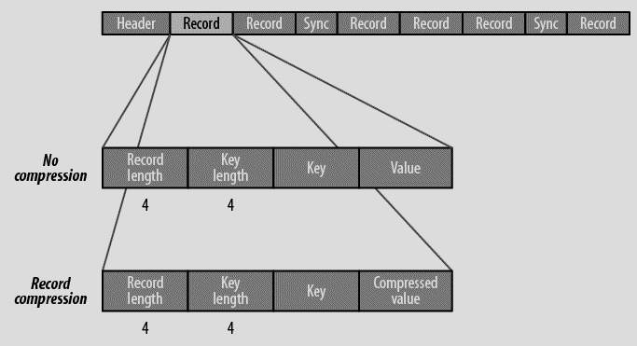
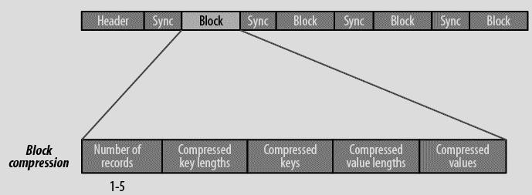
If compression is enabled, it can be record compression or block compression.
The format for record compression is almost identical to that of no compression, excepts the value bytes are compressed using the codec defined in header.
Note that keys are not compressed.
Block compression – compress multiple records at once.
Block compression is compact, and is preferred over record compression because it makes use of similarities between records.
Records are added until the block reaches its minimum size. (io.seqfile.compress.blocksize, def is 1 million bytes)
Sync marker is written before the start of every block.

Slide 9
Interview Question: which compression format is more compression aggressive?
The “Block-Compressed” format is more compression-aggressive. Data is not written until it reaches a threshold, and when the threshold is reached all keys are compressed together–the same happens for the values

Slide 10
Lab -
Program to create a sequence file and write data into sequence file format.
Program to read the created sequence file from above program and display its contents.
Display the file contents while writing and reading the file.
Identify and Display the sync points while reading the file.
Display the file written by first program using CLI.
Merge and Sort sequence files using
MR programming.
Using SequenceFile.Sorter

Slide 11
MapFile
Map file is sorted sequenceFile, and it also contains an index of keys to allow lookups.
The index of keys is again a sequenceFile that contains fraction of keys in the map( i.e every 128th key, by default).
The index can be loaded into memory to provide fast lookups from main data file.
Main is another sequenceFile containing all the map entrieis in the sordata ted key order.
Writing to MapFile is similar, the only restriction is that you should supply the keys in sorted order, otherwise IOException is thrown.

Slide 12
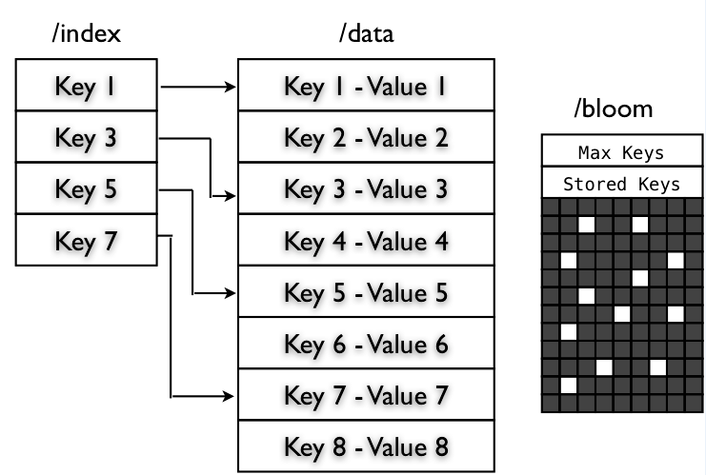
MapFile Varients
SetFile – MapFile to store ‘set’ of keys, (set doesn’t allow duplicates) and keys must be ordered. Values are NullWritable always.
ArrayFile – MapFile with key is an integer representing the index of the element in the array and the value is Writable value. Key = count+1.
BloomMapFile – MapFIle that offers fast version of get() method. Have additional bloom file, which contains added keys in memory, hence it is faster.

Slide 13
Other row file format is AVRO data files –
these are like sequence files, designed for large-scale data processing
Compact and splittable
Portable across programming languages.
AVRO data files have a schema, the programs in different languages reads the schema and can operate on the data.
Other formats are implemented in Java code – writables, makes code unmanageable by other languages, and java centric.
Avro data files are good choice for binary formats and supported by the components in Hadoop ecosystem.

Slide 14
Column-Oriented Format
Row Oriented formats, the values for each row are stored contiguously in the file.
Column-Oriented format,
the rows in a file(or a table in Hive) are broken into row splits,
Each split is stored in column-oriented fashion.
i.e values for each row in the first column are stored first, second column values are stored second and so on.
These format permits columns that are not accessed in a query will be skipped.
With Row-Oriented formats, the whole row is loaded into memory, even though only few columns are used in the query. (one optimization is do not deserialize the columns that you don’t want, but the cost of reading each row’s bytes from the disk cannot be avoided.)
With Column oriented storage, only parts of the file need to be read into memory.
Ingeneral – Column oriented works well when queries access only a small no of columns in the table. Use Row Oriented format when a large no of columns of a single row are needed for processing.

Slide 15
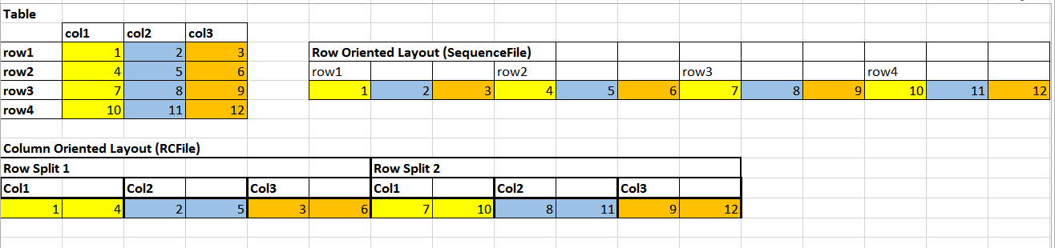
Column-Oriented cont..
Column oriented formats need more memory for reading and writing since the have to buffer a row split in memory, rather than just a single row.
These formats are not suited for streaming writes. i.e when the write fails, it is difficult to recover the file.
Row oriented formats like sequence file and Avro data files, we can read the file up to last sync point after a writer failure. This is why flume(streaming) uses row oriented formats.

Slide 16
Example Column oriented formats
Example Column oriented formats are –
Hive’s RCFile – Record columnar file.
Hive’s ORCFile – Optimized Record columnar file
Parquet – based in Google’s Dremel
Avro – Trevni format.

